Slide 1
Fully Memristive Spiking Neural Network with Forward-Forward Learning
By OOI HONG YAN (PETER)

Slide 2
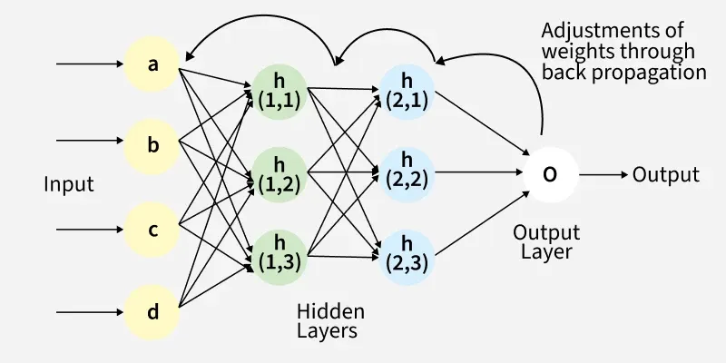
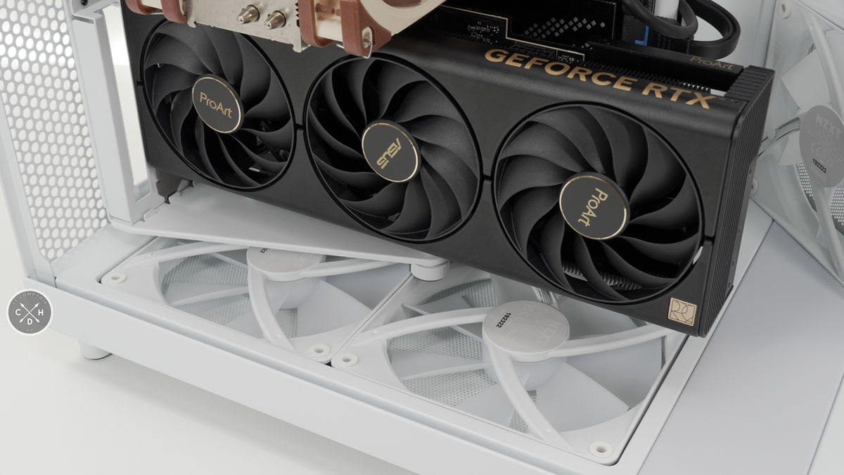
Problem Description
Artificial intelligence (AI) is now the forefront of modern computing
Modern AI relies on backpropagation and matrix operations for learning
For fast speeds AI runs on the GPU to take advantage of parallelism instead of CPU’s sequential nature
Source: GeeksforGeeks
Source: Comptoir-Hardware

Slide 3
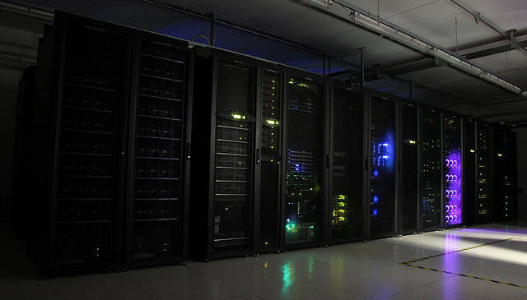

Problem Description
To run AI’s, datacentres use enough power to power an entire city
By 2026, the total energy used by data centers globally is projected to reach up to 1,050 TWh. The entire UK uses about 280–300 TWh. 3.5x more!
For edge devices, power usage is too high for powerful models to be run on small hardware.
Source: OchoBits
Source: Devopedia

Slide 4
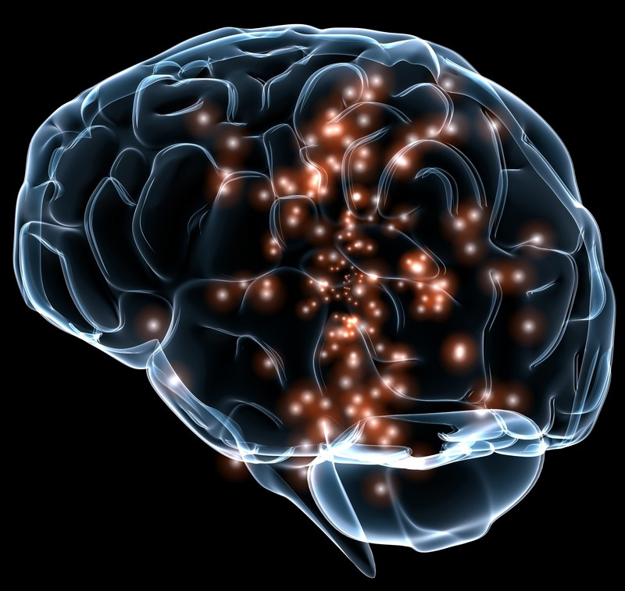
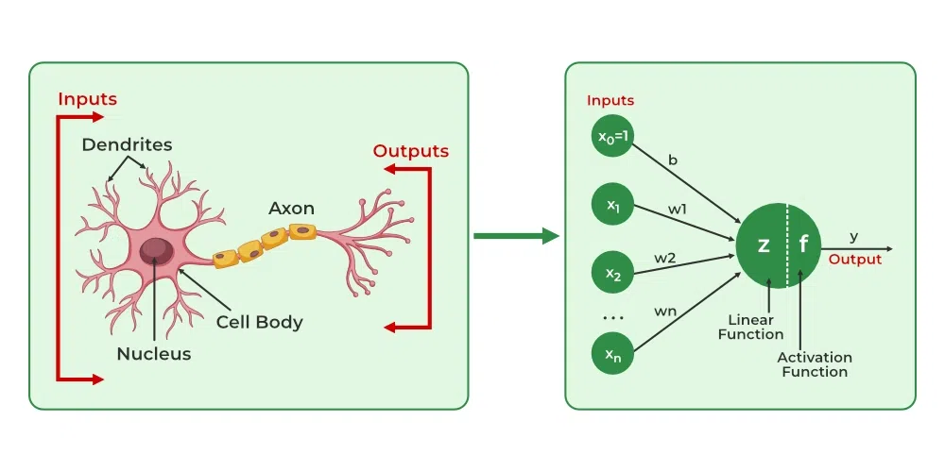
Problem Description
Our brain only uses about 20W
Biological Abstraction – Models use highly abstract version of neurons
Neurons are much more complicated, using temporal spikes to encode information
Von Neumann Bottleneck - GPUs need to fetch data from the VRAM, creating a memory wall
Global Backpropagation – Requires storing complex computational graphs and has no biological basis
Source: Noba Project (CC BY-NC-SA)
Source: GeeksforGeeks

Slide 5
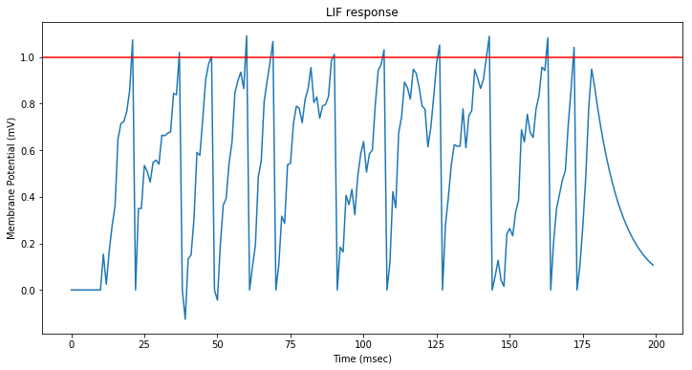
SNN
Closer to biological neurons, uses spikes instead of a singular value
Information is encoded in the timing of the spikes
Instead of using energy every cycle, energy is dependent on spike activity
Can run much more efficiently on neuromorphic hardware
Problem: Uses mathematical approximations to fake the smooth curves needed for learning
Source: Kaizou.org

Slide 6
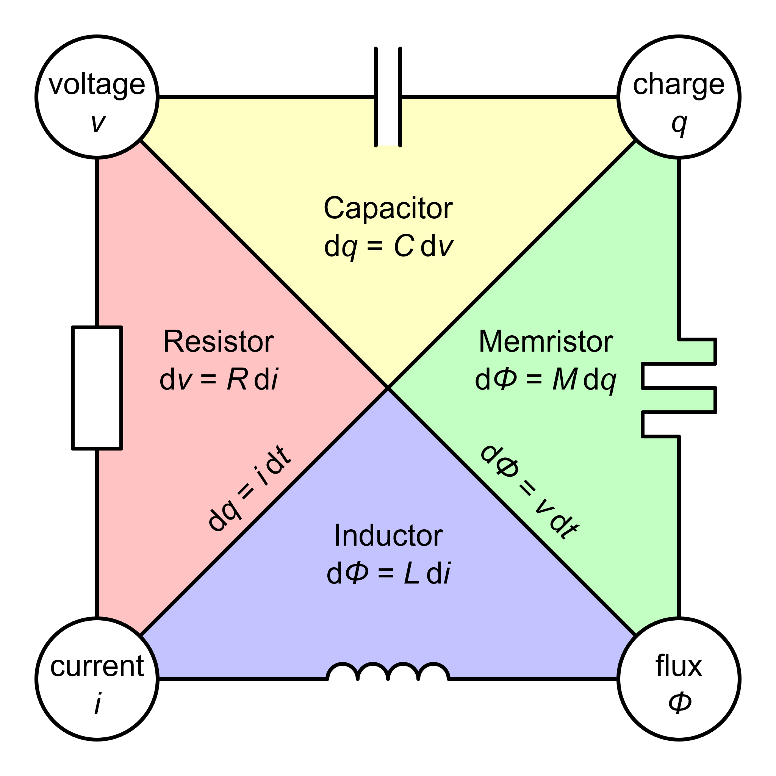
Memristor
Unlike other fundamental components, resistance is dependent upon its previous history; hence it has “memory”
Generates continuous analog voltage trajectories
Because of this it remain differentiable, solving the issue of approximations
Problem: Current memristor implementations use global backpropagation
Source: Wikimedia (CC BY-SA)

Slide 7
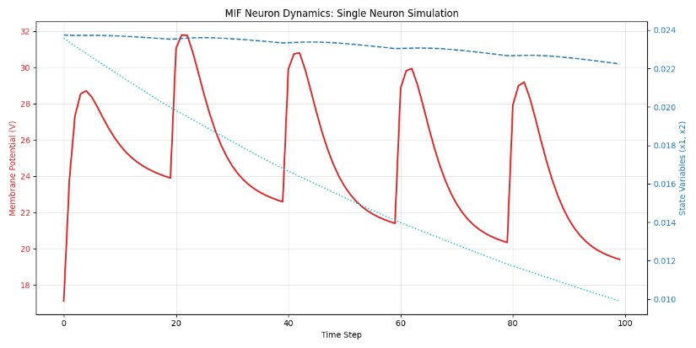
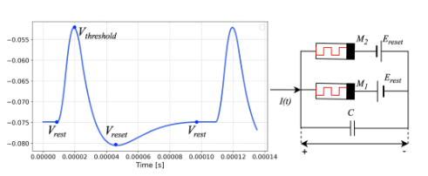
Fully Memristive Spiking Neural Networks (MSNN)
Memristive Integrate and Fire (MIF)
Parameters voltage (V), memristive conductance (G1,G2), capacitance (C) and device resistance (Ron/Roff)
Backpropagation through time (BPTT)
Source: Own Work (Reproduced with permission from X. Shi et al. 2025)
Source: Own Work

Slide 8
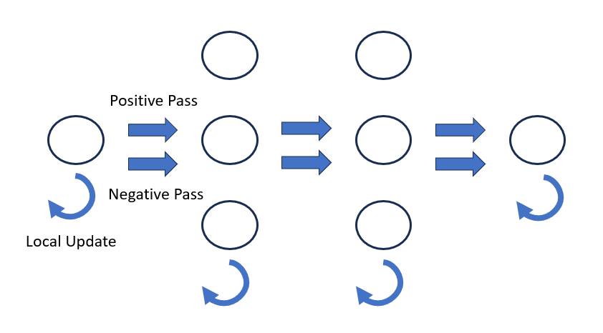
Forward Forward
Replaces global backpropagation with 2 forward passes
1 Positive pass and 1 Negative pass
Greedy layer wise learning
Goodness is calculated by the activity of the neurons
Each layer learns by maximising goodness on positive pass and minimising it on negative pass
Source: snnTorch Docs (CC BY 4.0)

Slide 9
My Contributions
Build upon the code that implements memristors
Integrate the forward-forward algorithm into the MIF
Evaluate it with against other models

Slide 10
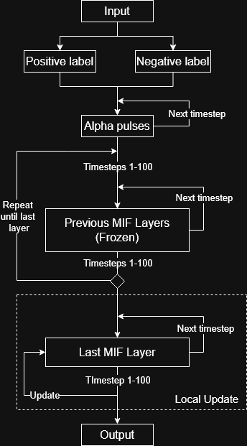
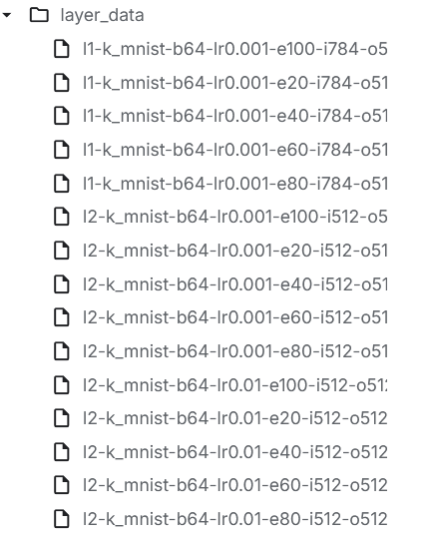
MSNN Forward Forward
Layers can be saved and checkpointed
Source: Own Work
Source: Own Work

Slide 11


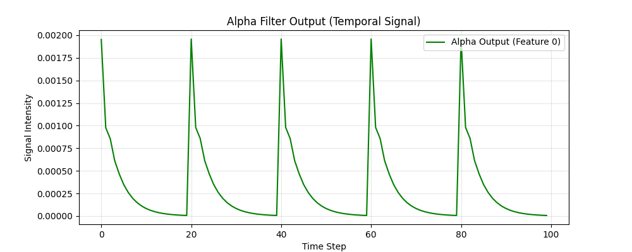
MSNN Forward Forward
Single batch – Single layer
Pos Data
Alpha
Last Layer
Data (batch)
Labelling
Neg Data
x pixels
x pixels

Slide 12
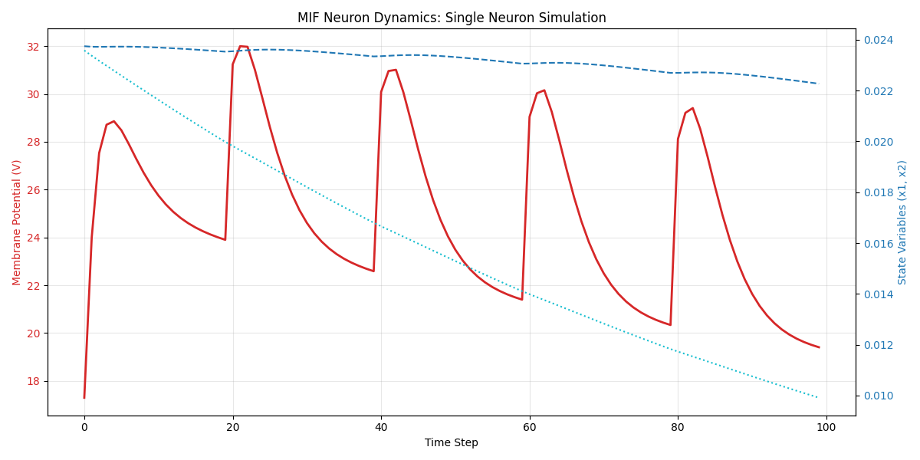
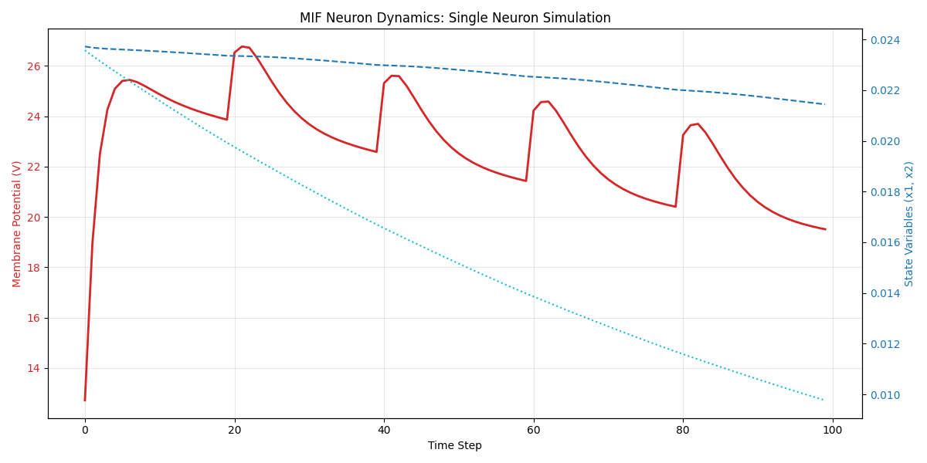
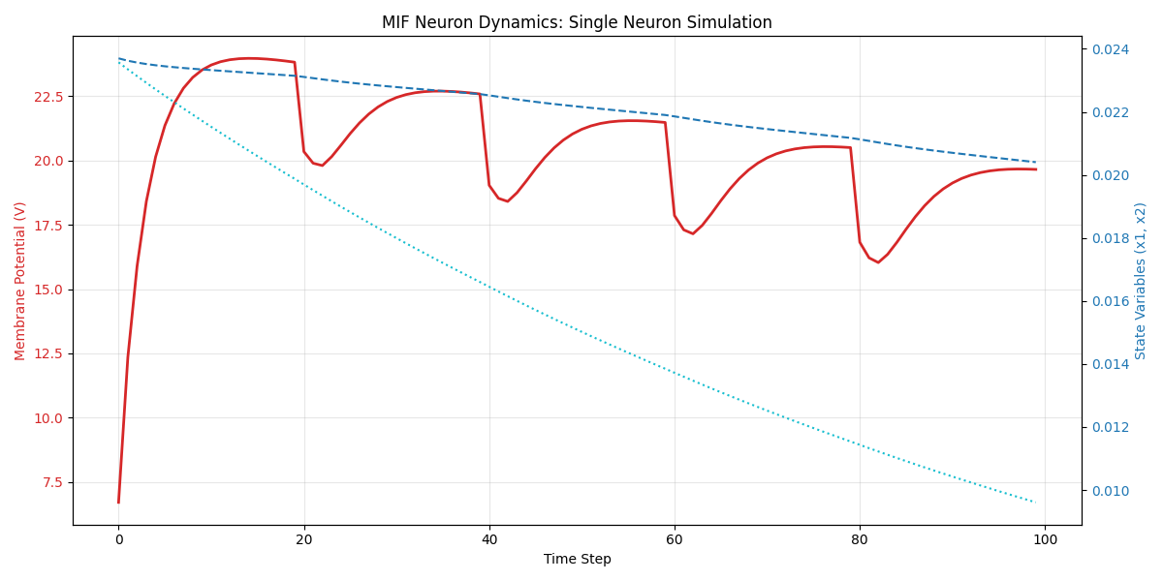
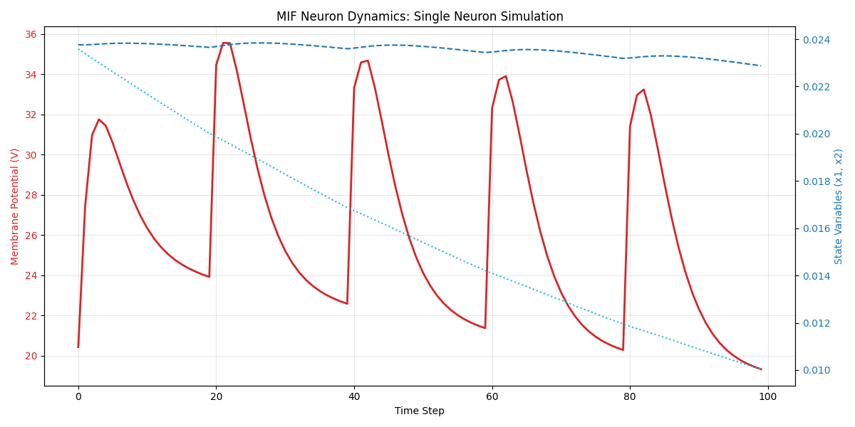
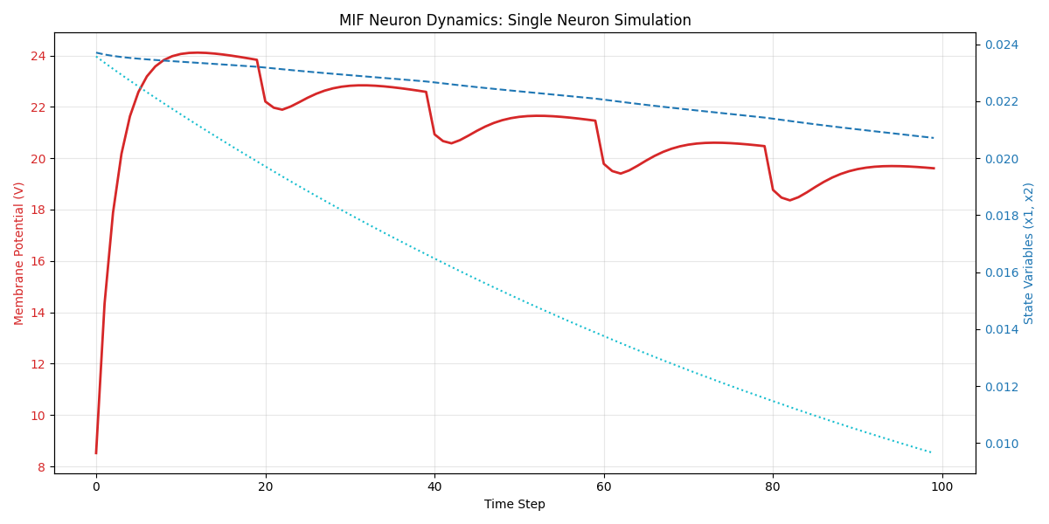
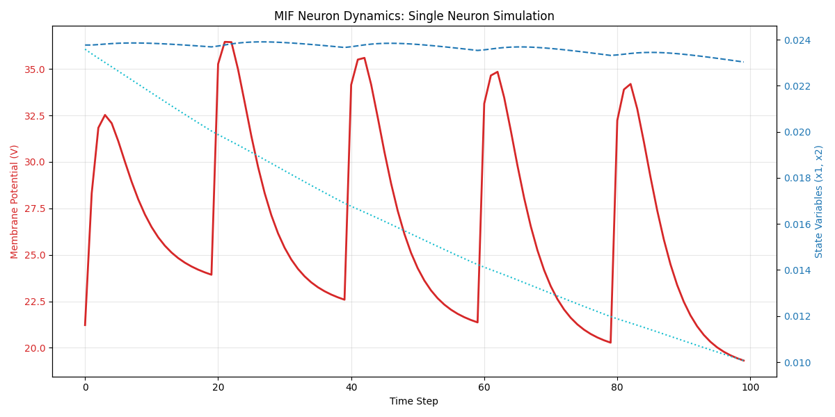
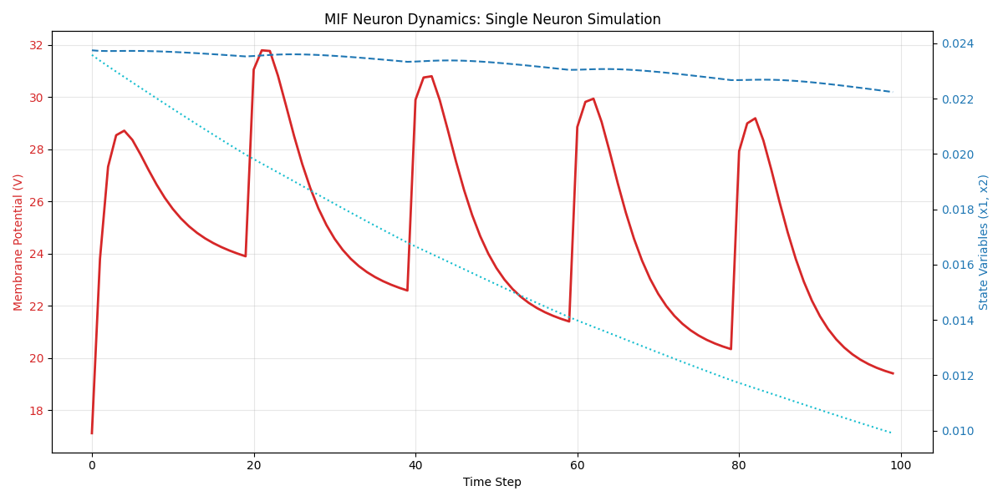
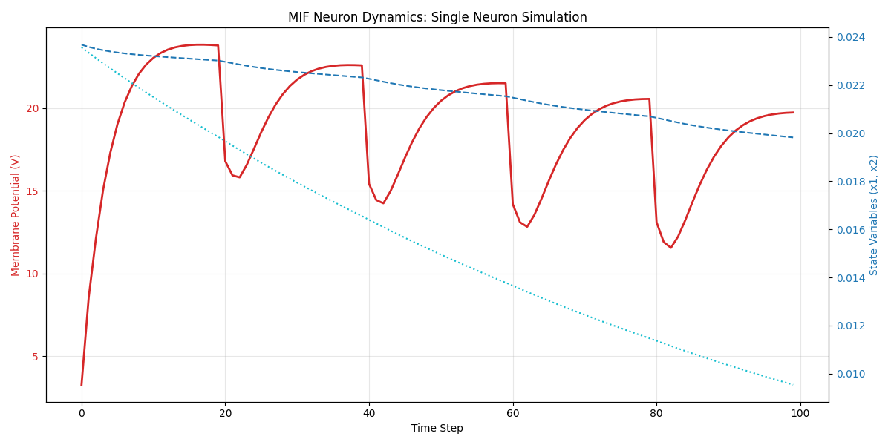
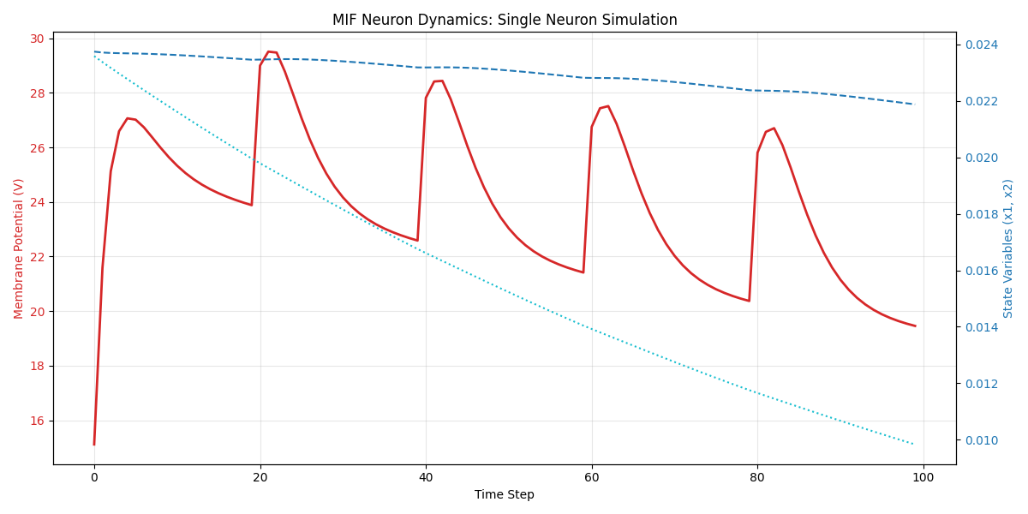
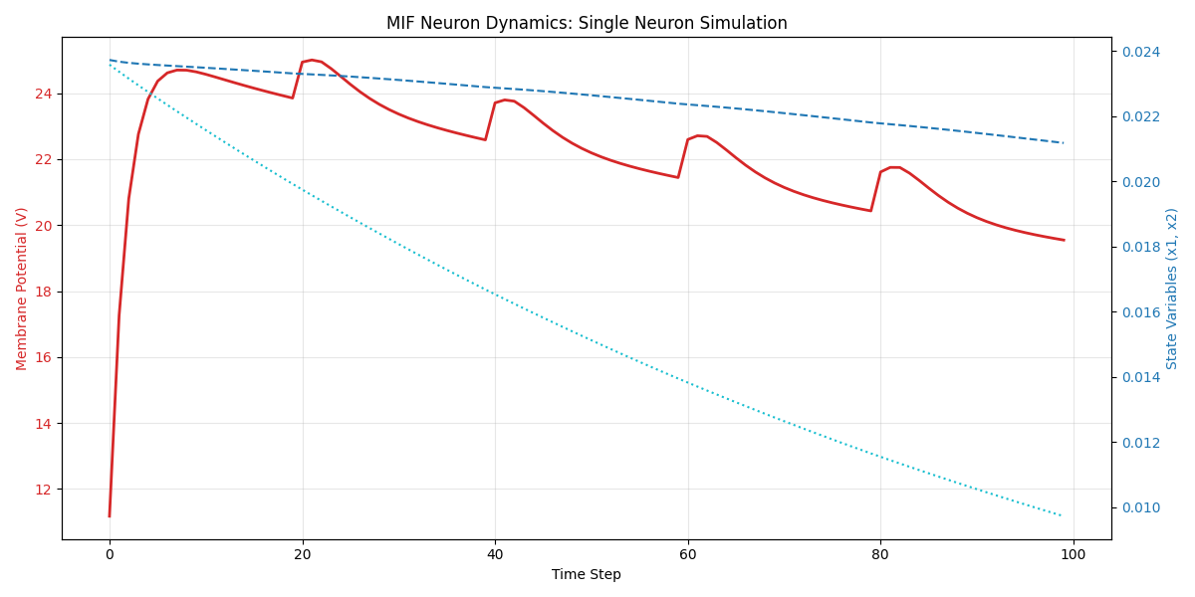
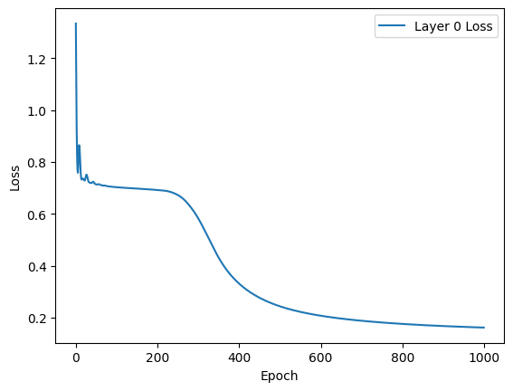


MSNN Forward Forward
Single batch – Single layer
$$g=\frac{1}{T}\sum_{t=1}^{T}{mean\left(v{\left[t\right]}^{2}\right)}$$
Last Layer
$$Loss=Softplus\left(θ−\left(g_{pos​}−g_{neg}​\right)\right)$$
Save Layer
x pixels

Slide 13
MSNN Forward Forward
Single batch – Multi layer
Last Layer
Loaded Layer n
Loaded Layer1
……………….
x pixels
x pixels
x pixels

Slide 14
MSNN Forward Forward
Single batch
Single batch learn process
Pos Data
Alpha
All Layers
Data (batch)
Labelling
Neg Data
x pixels

Slide 15
MSNN Forward Forward
Number of epochs
Single batch learn process
Single batch learn process
Single batch learn process
Dataset
Until all samples learned

Slide 16
MSNN Forward Forward
Inference
+
+
Positive Goodness
Positive Goodness
Positive Goodness
Correct Sample
Positive goodness sum =
500
Layer1
Next Layer
Last Layer
Layer1
Wrong Sample
Positive goodness sum =
497
……………
x pixels
x pixels
x pixels

Slide 17
System
Local Development
Python 3.13 and the PyTorch2 (CUDA 13.0) ecosystem.
NVIDIA GTX 1650 Ti mobile GPU
AMD Ryzen 7 4800H iCPU
16GB of 3200 MT/s SODIMM RAM
Colab and Kaggle
Python 3.11
NVIDIA T4

Slide 18
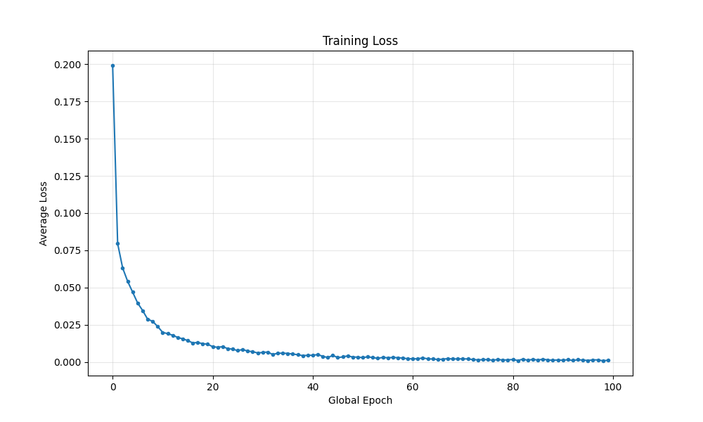
Tests
Training Loss
Plotting data from logs
Isolated neuron
Semi-implicit vs Explicit Euler
Source: Own Work

Slide 19
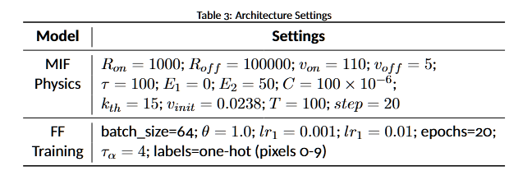
Experiment
Tested with MNIST, KMNIST and FashionMNIST
Source: Own Work

Slide 20
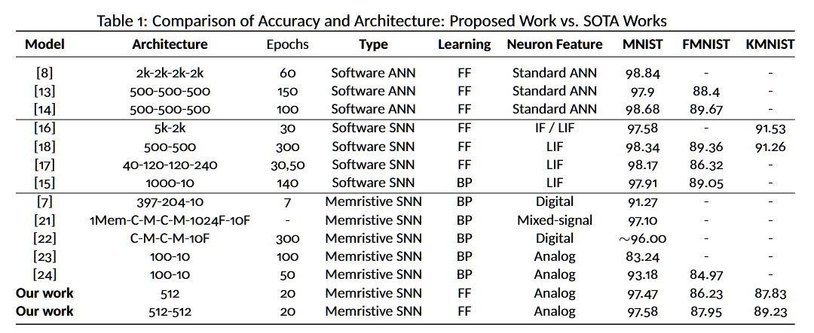
Results
Source: Own Work
Update: There is also the 40 epoch MNIST which got 98.21%!

Slide 21
Future Work
More datasets, like the DVS dataset
NoProp
Hormonal modulation networks
“Sleeping”
Implementation and benchmarks on real memristors

Slide 22
Thank you! Feel free to ask any questions

